Slide 1


CHANDLER EDUCATION FOUNDATION
SCHOLARSHIPS
2024-2025

Slide 2


Founded in 1986, the Chandler Education Foundation (CEF) is a 501(c)(3) nonprofit organization whose purpose is to ignite community fundraising to fuel access, innovation, and excellence within the Chandler Unified School District (CUSD).
Our priorities:
Equitable ACCESS to learning and enrichment opportunities.
INNOVATION that sparks curiosity and reimagines possibilities for the future.
Academic EXCELLENCE that kindles the potential of CUSD students, staff, and community.

Slide 3
SCHOLARSHIP OPPORTUNITIES
IMPACT
$1,000
DONOR
$500 - $5,000
Varying criteria
FOUNDATION
$1,000
Financial need
Community service

Slide 4

IMPACT CHANDLER – SERVICE LEADERSHIP

Slide 5


  Designed to facilitate support for the local community while providing students with professional development and recognition opportunities.
  Register online through Infinite Campus at any time
  3 levels of recognition

Slide 6

SCHOLARSHIPS
HONORS
PARTICIPATION
IMPACT LEVELS

Slide 7

REQUIREMENTS
  Enroll in IMPACT Chandler Program through Infinite Campus
  Volunteer in the local community and submit hours for approval
  Maintain high attendance and academics
PARTICIPATION
  Submitted & been approved for 100 hours+ of community service
  Maintained at least a 95% cumulative attendance
  Maintained a weighted GPA of at least 3.4
HONORS
  All of the requirements for HONORS +
  Submitted online scholarship application and been selected by the committee.
SCHOLARSHIP

Slide 8

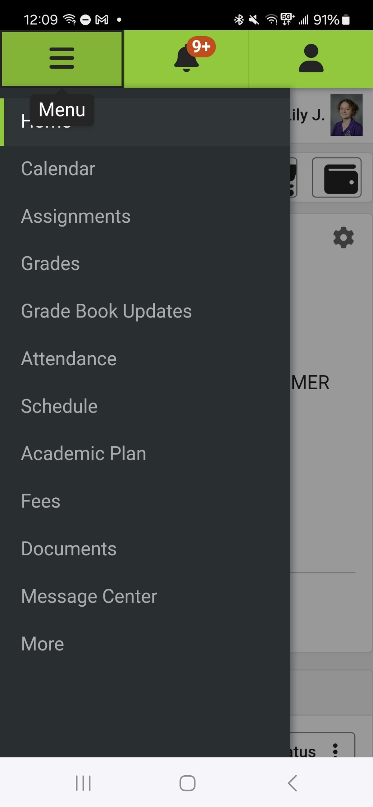
HOW TO REGISTER
  In Infinite Campus, click on the MENU button in the top left corner of your screen
  Click on ‘MORE’ at the bottom of the list of options

Slide 9
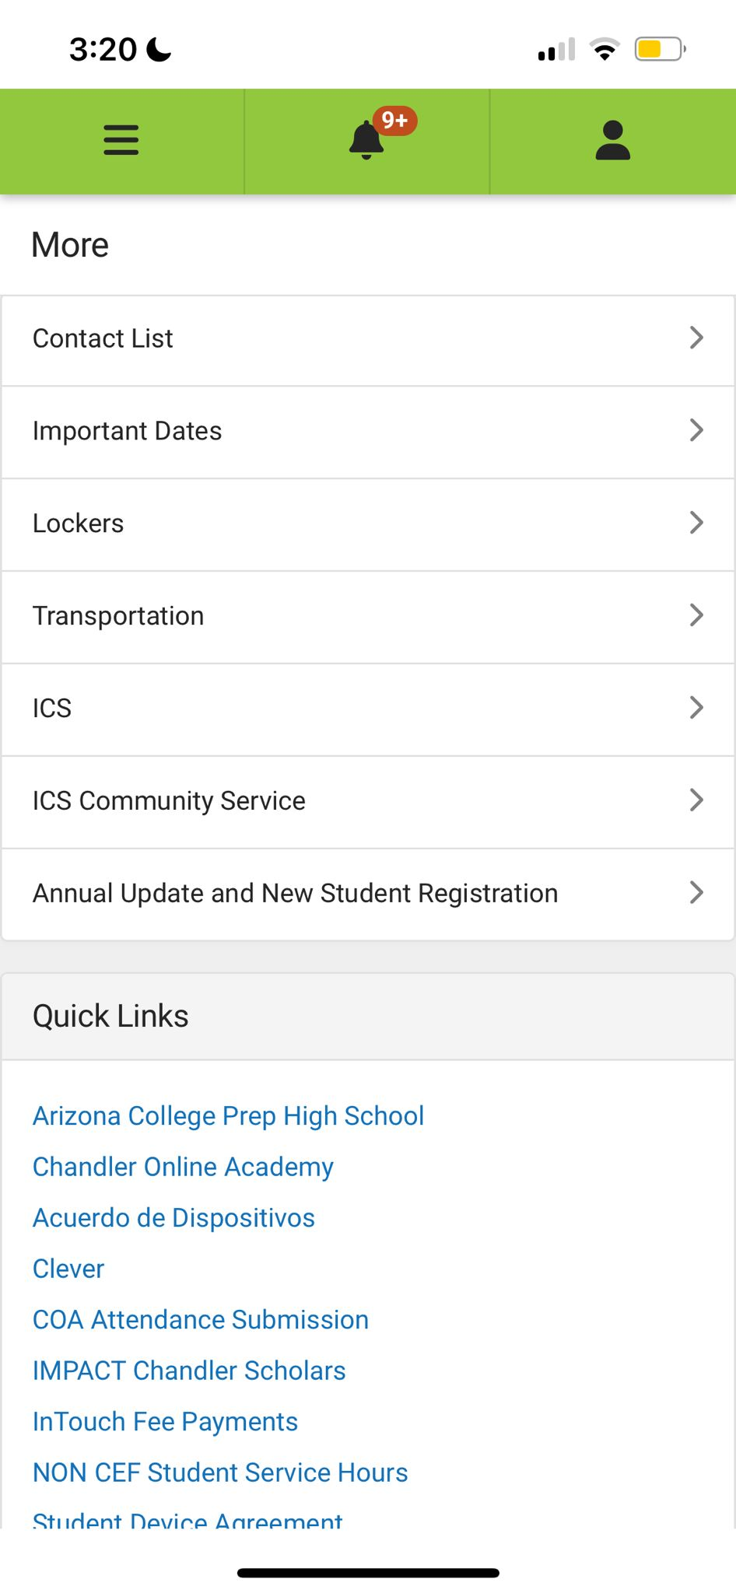
HOW TO REGISTER continued
  3. Click on ICS to register as a participant in the program
  Click on IMPACT Chandler Scholars to submit your hours

Slide 10
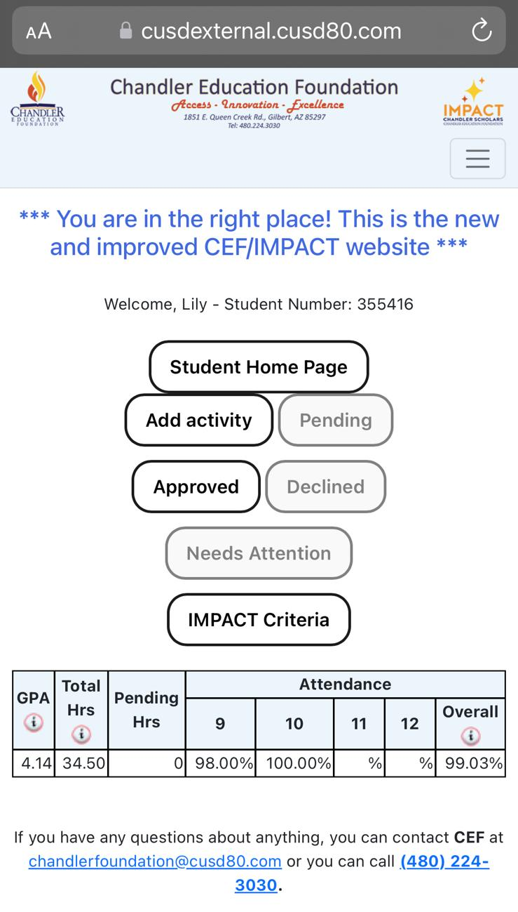
STUDENT DASHBOARD
  Summary of your IMPACT criteria to date.
  Navigation buttons:
  Add activity = submit hours
  Pending = hours that have been submitted but not yet reviewed
  Approved = chronological record of all approved hours
  Declined = chronological record of all declined hours
  Needs Attention = CEF staff have asked follow up questions about a submission that need to be answered before hours can be approved.
  IMPACT Criteria = reminder of the requirements and process for the program.

Slide 11
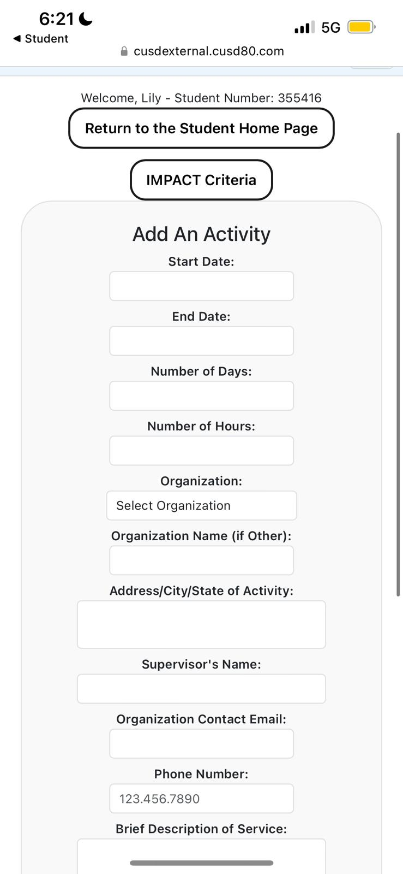
HOURS SUBMISSION
  When submitting hours:
  Only hours conducted during the current academic year are accepted.
  No more than 10 hours in a single day.
  Provide a thorough description that helps CEF evaluate the service activity.
  Use proper grammar and punctuation in submissions.
  Refer to the Program Criteria and Guidelines for activities that are eligible for submission.

Slide 12
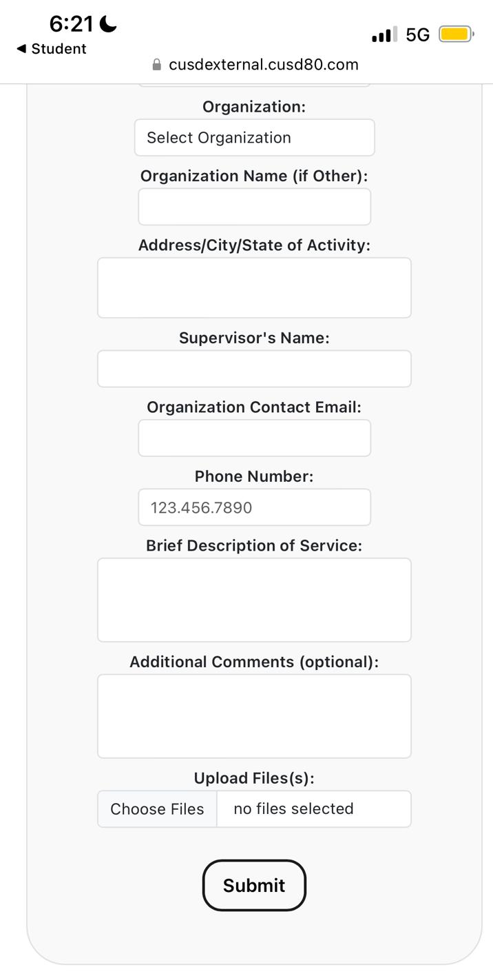
HOURS SUBMISSION
  File upload:
  Is optional.
  Helpful for service with organizations such as Feed My Starving Children to provide a photo of the work completed.
  After submitting, you and your parent will receive a confirmation email and you will be able to see the submission under ‘Pending’ on your dashboard.

Slide 13
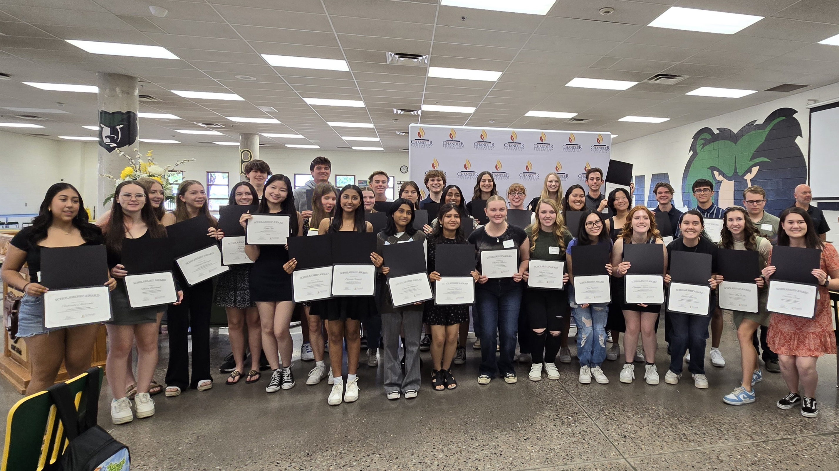
DONOR SCHOLARSHIPS

Slide 14
DONOR SCHOLARSHIPS
More than 100 awards available established and funded by local individuals and organizations to support CUSD students.
Award criteria varies based on the priorities of the Donor.
Seniors will fill out one universal application form and based on your responses, you will be notified which scholarships you are eligible for.
Some will have additional essay or other questions you will need to submit to be considered.
Students can win multiple awards.
Award winners are invited to attend the Scholarship Celebration at your school where you will have a chance to meet and thank your donor.
Once enrolled at your college/university/technical school, you will upload documentation verifying enrollment for the check to be processed.
HEADER
HEADER

Slide 15

FOUNDATION SCHOLARSHIPS

Slide 16
FOUNDATION SCHOLARSHIP
    New for 2025!
    Some students are not able to volunteer or earn high grades due to work or family commitments.
    Aims to support students with financial need who want to pursue further study but don’t meet the ‘traditional’ scholarship requirements.
    Must complete the universal application form and based on responses, additional questions or an essay will need to be submitted to be considered for the Foundation Scholarship.

Slide 17
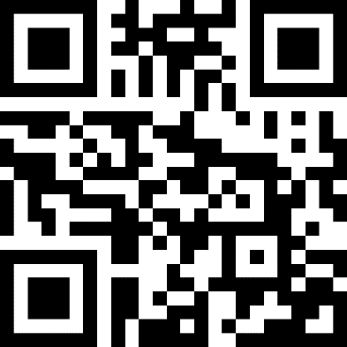
HOW TO APPLY
    Visit: https://www.chandleredfoundation.org/what-we-do/scholarships/
    Scroll down to the Apply Online button, click, register, and select the CEF Universal Application to start.
    NOTE:
    Application platform will open January 6, 2025.
    Deadline to submit is Monday, March 24, 2025 (last day of Spring Break)
    Some applications will require FAFSA information to submit
    Be sure to ask your references in advance for their permission.

Slide 18

QUESTIONS?
    CONTACT CEF:
    info@chandleredfoundation.org
    480-224-3030
    www.chandleredfoundation.org
    @chandleredfoundation

Slide 19
THANK YOU!

